Slide 1


Identifying Disinformation
Authors: David Burrus, Ginna Woo, Jianci Zhai (Angela)
Notes:
Hi Everyone, Welcome to our project – our topic is centered on Identifying Disinformation. Our Team lead is David Burrus, and we have two additional members – Ginna Woo and Jianci (Angela) Zhai.
Now, lets jump into our topic.

Slide 2

Table of Contents
What is Disinformation?
Design & Concept
Team Contribution
Diving into the Code
Challenges
Prerequisites: Packages and Language
Notes:
Here is a quick overview of our main topics – we’ll start off introducing our project and our ideas. We'll then jump into exploring our code and provide an explanation on our analysis development. We'll highlight our challenges and end our presentation with improvements to consider.

Slide 3
What is disinformation
Dissemination of information that is deliberately misleading (disinformation) or simply inaccurate (misinformation) has been recognized as a threat to society.
Disinformation that elicits emotional response from users tend to receive more click-throughs and is therefore favored by search engines.
It has become more and more difficult for individuals to determine which content is based on facts because of the unlimited sources of information available today.
By providing a “disinformation score” for each search result, our “search result markup” browser extension will influence user click-through by navigating the users towards more reliable sources.
We use COVID-related content as an example to elaborate how we can add the extra score to help users identify misinformation.
Notes:
The spread of misinformation and disinformation has affected our ability to improve many aspects of our lives – and this can be health related (COVID19) or even climate change for example. With so many information around us, it is extremely difficult to differentiate what is true information. Our goal here is to develop a tool to provide valuable insight on the information we received to help users identify disinformation. Our analysis program will produce disinformation scores for the end users to inform them of the level of disinformation allowing the user to make more inform decisions on content they are consuming. In the next few slides we will explore our goals and dive deeper into our code.

Slide 4
Project Objectives (as proposed)
Screen scrape search results from user query, focusing on organic rather than sponsored or paid results.
Visit each URL in the search results to scrape relevant text data, including headings, body, out-links, and author.
Analyze the content returned with topic mining and sentiment analysis.
The URL provides direct context by indicating an affiliation, so incorporate judgments from "authorities" who provide reliable, transparent assessments of the trustworthiness of websites.
Display search engine results to the user with an additional icon indicating level of accuracy or disinformation, so that users can make a more informed judgement.
Notes:
Here are our original project objectives. [Read them.]

Slide 5
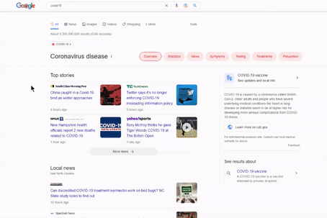

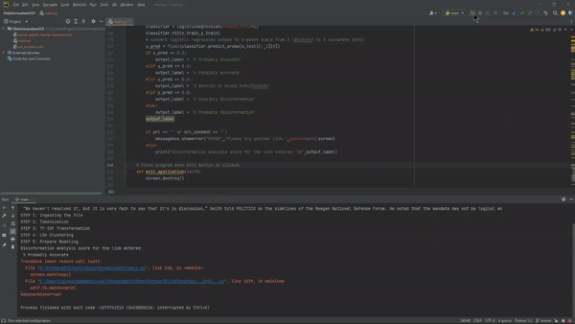
DESIGN & Concept
Design & CONCEPT
The original concept involved developing an extension (plug-in) to modify search engine results by injecting our disinformation analysis directly onto the search result page (see below).
However, due to limitations (issues with integrating Python and JavaScript codes) the team opted to create an interface to allow our users to input values for the program to run its analysis.
Figure 0.1 - Original concept involves projecting misinformation/disinformation scores.
Figure 0.2 - Revised concept captures user inputs and projects analysis.
Notes:
We attempted to follow through our original concept which involves developing an web extension to directly modify the search engine results by integrating our model and injecting our disinformation analysis directly onto the search result page as seen in Figure 1.0. However, we came across several issues with compiling two different languages as web extensions are written in JavaScript – our model code was developed using Python. Given our time constraints as well – we opted to create an alternative solution that involves creating a user interface that take in user inputs instead (see Figure 1.1). The inputs will be used to kick-off the analysis. In the next section, we will talk more about the code and how the analysis is performed.

Slide 6
Project Submission
Our project submission includes four files in total – two data files and two code files:
covid_search_results_summary.xls : Excel file containing over 240 search engine results for various COVID-related queries. These data are used to train and test the analytical models.
url_accuracy.xls : Excel file containing over 3,400 judgments of website factual accuracy, based on assessments from organizations like MediaBiasFactCheck, NewsGuard, HON, and others. These data are used by the models.
CS410_COVID_Notebook_A.ipynb : Python notebook that scrapes results from three search engines, builds a model, and assesses its accuracy. This program requires the two data files above. Of the five project objectives, Notebook A achieves 1 through 4. However, it does not provide an interactive way for a user to enter his or her own choice of websites to analyze.
CS410_COVID_Notebook_B.ipynb : Python notebook that provides an interactive assessment of user input. This program also requires the two data files above. Of the five project objectives, Notebook B achieves 2 through 4 and provides a way for users to enter a website for analysis. Finally, Notebook B uses a different modeling technique, so the reviewer can see the performance of different methods.
All files may be downloaded from the GitHub repository containing the project proposal and progress report.
Notes:
Our submission includes four files, listed here and submitted through teh GitHub repository used for the team's prior submissions. There are two code files that address different parts of the project and that explore modeling in different ways. And there are two data files used by the two code files.

Slide 7
Notebook A – Overview & Implementation
Notebook A has six sections:
Scrape search results – This code section demonstrates that is possible to scrape search engines such as Bing, Google, and Yahoo. However, this task proved much more complex than expected. We found that some search engines block attempts at scraping or crawling. Such blocks can be circumvented sometimes, but not always, by continuously changing USER_AGENT and other parameters.
Collect “search engine result” text data as well as context and judgment data – This section:
Loads ‘covid_search_results_summary.xls’ is lieu of scraped search engine results. To minimize running time, the Excel file already contains website text and URL.
Visits each URL in the “search results” to collect additional context such as heading text and out-links. (Attempts to collect author were not successful, because different website indicate author in different ways or not at all.) This operation can take two or three minutes. Websites that ‘time out’ or refuse the request are bypassed and an error is reported.
Loads ‘url_accuracy.xls’ and incorporate the judgments of these authorities into the data set.
Adds top-level domain (e.g., edu, gov, com, net) to the data set as a possible feature for the model. This is based on the supposition that certain TLDs such as edu and gov tend to be very reliable.
Plots some exploratory data analysis. Please note that all program output is displayed within the Jupyter notebook.
Perform sentiment analysis using the NLTK package
Pre-process text data – This code cleans, tokenizes, and stems the text data in preparation for modeling, then plots word frequencies.
Process text data – This code builds features that will be used to train and test the model.
Build classifier – This final section creates a Support Vector Machine model, trains and tests it, then displays the model’s accuracy, precision, recall, and F1 score.
Notes:
The first code file, Notebook A, is a Jupyter notebook that illustrates the difficulty of scraping search engine results. Once it became clear that our original vision could not be achieved in the available time, we created a set of COVID-related search results that could be loaded from an Excel file. The reviewer can imagine, with a little more time, it might be possible to obtain such data directly from one or more search engines.
For each "search engine result", our data set combines the URL and text content with additional context including heading text and outlinks on that URL, a single-user judgment, an expert judgment (where available) and domain information.
The data set is analyzed using techniques discussed in class: removing stopwords and punctuation, tokenizing and stemming words, sentiment analysis, and so on. Both code files perform similar text transformations and processing.
However, Notebook A tries a discriminative modeling approach, while Notebook B tries a more generative approach. It has been interesting to compare the results.

Slide 8
Notebook A – Sample Output from Section 1 (Scraping)
BING results from covid+vaccine ---------------------------
title \
0 Vaccines for COVID-19 | CDC
1 Vaccines.gov - Find COVID‑19 vaccine locations near you
2 Overview of COVID-19 Vaccines | CDC
3 COVID-19 vaccine - Wikipedia
4 COVID-19 Bivalent Vaccine Boosters | FDA
5 Covid-19 vaccines could cost billions more if federal government …
6 FDA approves Bivalent COVID-19 Vaccines for children 6 months …
7 FDA clears updated COVID-19 vaccines for kids younger than age 5
8 Congress poised to rescind COVID-19 vaccine mandate for troops
9 Coronavirus (COVID-19) Update: FDA Authorizes Updated …
link \
0 https://www.cdc.gov/coronavirus/2019-ncov/vaccines
1 https://www.vaccines.gov
2 https://www.cdc.gov/coronavirus/2019-ncov/vaccines/...
3 https://en.wikipedia.org/wiki/COVID-19_vaccine
4 https://www.fda.gov/.../covid-19-bivalent-vaccine-boosters
5 https://www.cnn.com/2022/12/07/politics/covid-19-vaccines-federal-government
6 https://www.wxyz.com/news/fda-approves-bivalent...
7 https://www.ky3.com/2022/12/08/fda-clears-updated...
8 https://www.cbsnews.com/news/congress-rescind...
9 https://www.fda.gov/news-events/press...
snippet
0 WebMay 17, 2022 · Get a COVID-19 vaccine Stay up to date After Vaccination Get your vaccination card Possible side effects Register for v-safe COVID-19 Vacc...
1 WebWe want to make COVID‑19 vaccination easy and accessible to everyone. COVID‑19 vaccines are free and available to anyone who wants one. We work with part...
2 WebNov 01, 2022 · Types of COVID-19 Vaccines Available There are four approved or authorized vaccines in the United States. Pfizer-BioNTech and Moderna COVI...
3 A COVID‑19 vaccine is a vaccine intended to provide acquired immunity against severe acute respiratory syndrome coronavirus 2 (SARS‑CoV‑2), the virus that c...
4 WebNov 16, 2022 · COVID-19 vaccines can help protect against severe illness, hospitalization and death from COVID-19. As the virus changes and your immunity...
5 Web19 hours ago · The federal government has spent more than $30 billion so far on Covid-19 vaccines to promote their development and ensure that people can...
6 Web59 minutes ago · The Moderna COVID-19 Vaccine, Bivalent is also authorized for use in individuals 6 years and older as a single booster dose at least two...
7 Web29 minutes ago · Pfizer is asking U.S. regulators to authorize its updated COVID-19 vaccine for children under age 5. The youngest tots already are suppo...
8 Web1 day ago · The COVID-19 vaccine mandate for members of the U.S. military would be rescinded under the annual defense bill heading for a vote this week i...
9 Web1 hour ago · The safety of a single booster dose of the Moderna COVID-19 Vaccine, Bivalent for children 6 months through 5 years of age is supported by s...
GOOGLE results from covid+vaccine -------------------------
title \
0 Vaccines for COVID-19 - CDC
1 Stay Up to Date with COVID-19 Vaccines Including Boosters
2 Vaccines.gov - Find COVID‑19 vaccine locations near you
3 Vaccine Information - IDPH - Illinois.gov
4 Vaccination Locations - State of Illinois Coronavirus Response
5 Schedule a COVID-19 Vaccine | CVS Pharmacy
6 Is the COVID-19 Vaccine Safe? - Johns Hopkins Medicine
7 COVID-19 Vaccine & Booster – Information & Records
8 COVID-19 Vaccine - UI Health
9 COVID-19 Vaccination - Chicago Public Schools
link \
0 https://www.cdc.gov/coronavirus/2019-ncov/vaccines/index.html
1 https://www.cdc.gov/coronavirus/2019-ncov/vaccines/stay-up-to-date.html
2 https://www.vaccines.gov/
3 https://dph.illinois.gov/covid19/vaccine.html
4 https://coronavirus.illinois.gov/vaccines/vaccination-locations.html
5 https://www.cvs.com/immunizations/covid-19-vaccine
6 https://www.hopkinsmedicine.org/health/conditions-and-diseases/coronavirus/is-the-covid19-vaccine-safe
7 https://www.walgreens.com/topic/promotion/covid-vaccine.jsp
8 https://hospital.uillinois.edu/primary-and-specialty-care/infectious-diseases/covid-19-coronavirus/vaccine
9 https://www.cps.edu/services-and-supports/covid-19-resources/covid-19-vaccination/
snippet
0 Learn about COVID-19 vaccine planning, how vaccine recommendations will be made, and the work going into ensuring the safety of COVID-19 vaccines.
1 CDC recommends that people ages 5 years and older receive one updated (bivalent) booster if it has been at least 2 months since their last COVID-19 vaccine ...
2 Vaccines.gov helps you find clinics, pharmacies, and other locations that offer COVID‑19 vaccines in the United States.
3 A safe and effective COVID-19 vaccine is a critical component of the U.S. strategy to reduce COVID-19-related illnesses, hospitalizations, and deaths.
4 If you missed your second dose appointment, you need to find a provider that carries the same vaccine you received for your first shot. In Vaccines.gov, you...
5 Updated booster vaccines targeting the latest COVID-19 variants are recommended by the Centers for Disease Control and Prevention (CDC) for age 5 and older ...
6 COVID-19 Vaccine Safety — What We Know · The Pfizer and Moderna vaccines are strongly recommended as safe and effective at preventing serious illness or dea...
7 Find information and answers to your questions about the COVID-19 vaccine, including scheduling, kid's shots, boosters, additional doses, records and more.
8 COVID-19 Vaccine at UI Health. located in Chicago. is providing the COVID-19 vaccine based on CDPH guidance. All Chicago residents are encouraged to get the...
9 If you're ready to get yourself or your child vaccinated, you can find appointments using this site. The FDA & CDC have authorized an updated COVID-19 vacci...

Slide 9
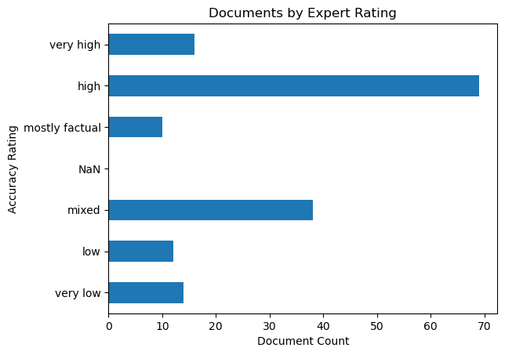
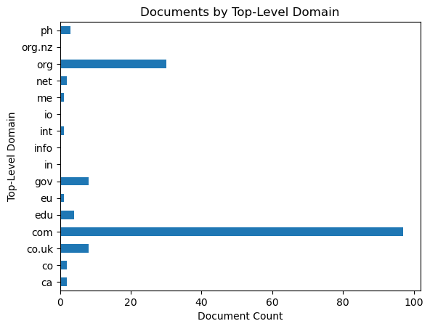
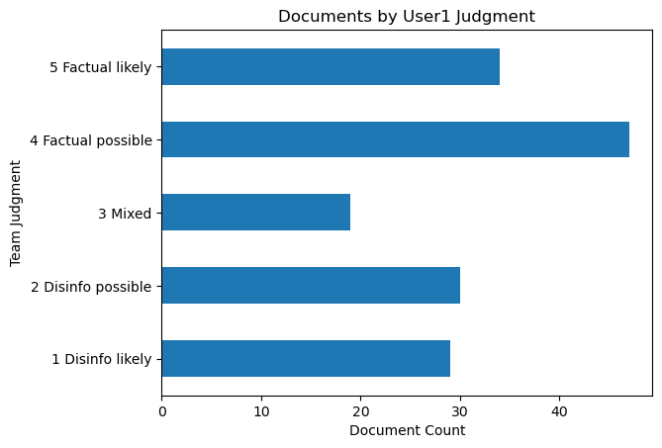
Notebook A – Output from Section 2 (Data Collection)
These charts show some exploratory data analysis after data have been loaded from:
‘search results’ Excel file (covid_search_results_summary.xls)
expert judgments Excel file (url_accuracy.xls)
headings (h1 and h2) and outlinks for every URL in the ‘search results’
top-level domain (edu, gov, com, etc.) calculation for every URL in the ‘search results’
By design, the ‘search results’ data set contains a good mix of accurate information and disinformation.
Expert judgments could be applied to 66% of the ‘search result’ rows (159 of 242)
One team member added her own opinion to all ‘search result’ rows. There was some consistency between that opinion and expert judgments.
The top-level domains, however, are not sufficiently diverse to be very useful.

Slide 10
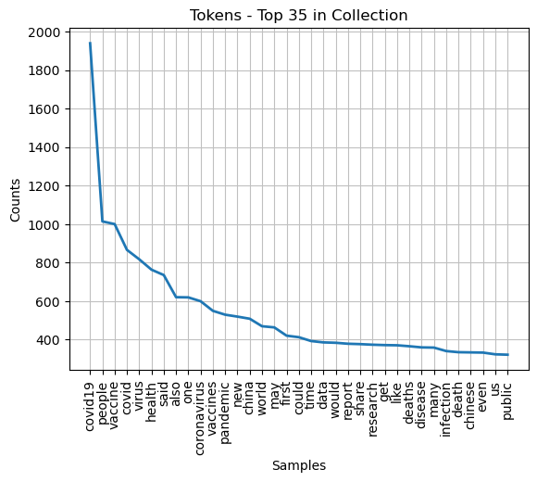
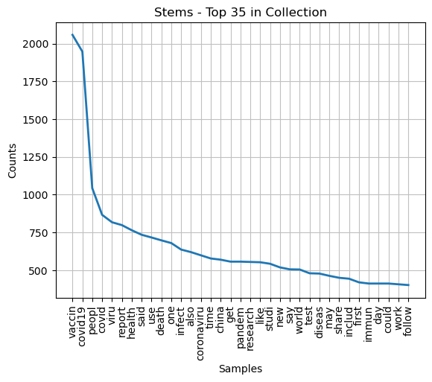
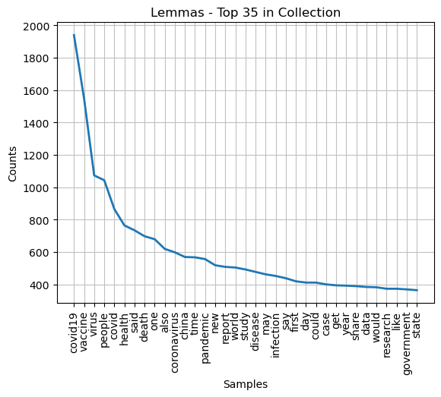
Notebook A – Output from Section 4 (Pre-Processing)
This section tokenizes 'content' from each search result, including removal of standard and unusual punctuation, numbers, and stop words.
Not knowing which form would be most helpful, we explored the differences between the tokens as-is, after lemmatizing, and after stemming. Stemming results could be difficult to interpret (e.g., 'caring' can stem to 'car'). Lemmatization produced a slightly longer list of words than stemming, but those words are easier to understand in later analyses.
The frequency distribution plots for all three forms show an 'elbow', suggesting that words like 'vaccine', 'people', and 'covid' are common throughout the collection, so TF-IDF could be helpful. However, one also can see some possible discriminative words, such as 'health', 'supplement', 'infection', and 'data'.

Slide 11
Notebook A – Output from Sections 5 and 6 (Modeling)
Notebook A builds a model using expert judgment as the dependent variable. This means there are only 159 records for both training and testing.
After looking at “fake news classification” research to see which methods are reported to work well and work poorly, we decided to try a discriminative algorithm, Support Vector Machine.
Experienced researchers have obtained accuracies of 84% to 89% with SVM. Unfortunately, our model and data set did not perform nearly as well:
If we consider adjacent categories (e.g., choosing ‘high accuracy’ when the correct answer was ‘very high accuracy’) as a kind of success, then the model’s performance is somewhat better. However, the model still misses at least 7 out of 31 (22%) during testing. These are highlighted in red.
Our model’s performance probably was influenced by having only a small dataset (242 records in the Excel file, of which only 159 have a dependent variable) for training and testing.
Large datasets of accurate COVID information are available, such as CORD-19. These could be hepful for future development. However, we did not find any large and readily available corpus of COVID disinformation documents and text. It seems that a robust model would need to be trained with both accurate information and disinformation.
Comparison of actual vs. predicted ratings:
y_test y_pred
0 high mixed
1 high high
2 high high
3 very low high
4 low high
5 high high
6 high high
7 low high
8 mixed mixed
9 very low high
10 mixed mixed
11 high high
12 mostly factual high
13 very low high
14 mixed mixed
15 high mixed
16 very low high
17 high high
18 mostly factual high
19 mixed high
20 high high
21 very high high
22 high high
23 high high
24 mixed high
25 high high
26 mixed mixed
27 low mixed
28 high high
29 mixed high
30 mixed high
31 very low high
y_test y_pred
high high 11
mixed 2
low high 2
mixed 1
mixed high 4
mixed 4
mostly factual high 2
very high high 1
very low high 5
Name: y_pred, dtype: int64
Feature dimensions:
(159, 60)
Label dimensions:
(159,)
Building classifier model ...
Number of features: 60
Class labels: ['high' 'low' 'mixed' 'mostly factual' 'very high' 'very low']
Number of support vectors for each class: [56 9 30 8 15 9]
Accuracy: 15 of 32 samples were classified correctly
Accuracy: 0.46875
Precision: 0.46875
Recall: 0.46875
F1: 0.5660377358490566

Slide 12
Note book A – Usage
Notebook A requires the following packages to be installed prior to use: tldextract, requests, bs4, urllib, requests_html, nltk, and sklearn as well as standard packages numpy, pandas, matplotlib, os, string, and collections.
Notebook A can be run cell by cell. This allows the user to see the output of each section and to read code comments that are more detailed than the overview on the previous page.
Alternatively, Notebook A can be run all at once by selecting “Run All” from the Jupyter “Cell” menu. The two most time-consuming operations are (a) collecting context data from every URL and (b) tokenizing the text. Both should finish in about three minutes or less, but users who do not wish to wait may select “Run All” then review the output at their leisure.
Notebook A has been tested with Anaconda running Python 3.7 and higher.
Notes:
Here is a list of Python packages that must be installed prior to running Notebook A. Please note that Notebook B also uses many of these packages, and a few others as well.
Notebook A requires no user input. It can be run either cell-by-cell, or all at once, as the reviewer prefers. All of this program's output, including plots and performance statistics, are displayed within Jupyter.

